Slide 1
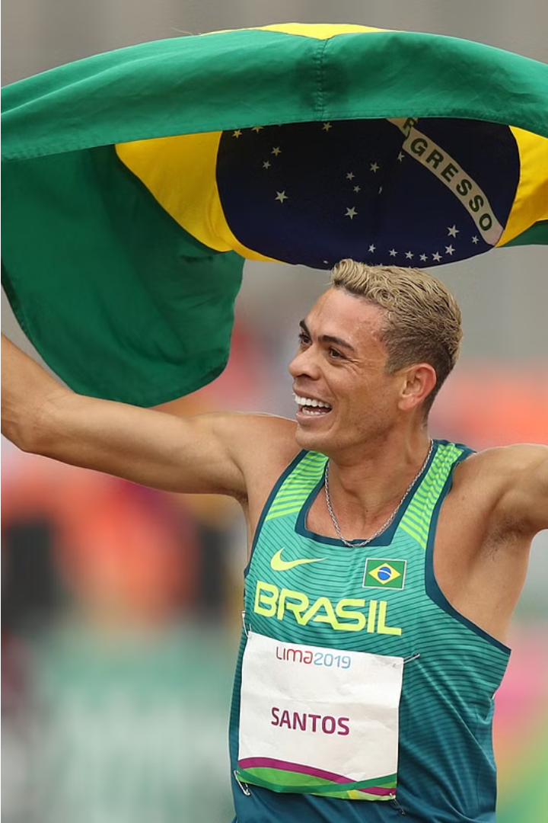

IHC – Assignment n.2
Project Title: CAP
Group: Ricardo, João & Miguel
Lab Class: P6

Slide 2

Introduction
1-Brief Contextualization / Motivation
2-Why This Project?
3-Personal Interest

Slide 3
Project Objectives
Define High-level Goals-
Create a better application for athletes, coaches and users alike to find the information they want about Portuguese Athletics
Create a dynamic navbar with all the links to other pages
Create tables where the information is stored and displayed clearly to the user
Add options like search bars, sorting options, pagination, so the user can more easily find the information they want to find
Create beautiful pages where the user interaction is clearly visible.
What Are the Expected Outcomes?
Producing an interactive, simple to use and visually pleasing website for users to find the information about Portuguese Athletics they so desire.
Making the user experience all the more enjoyable
What Are the Benefits? -
Coaches will now be able to more easily search for specific competitions for their athletes to partake on and then register them.
Athletes will be able to more easily view theirs and other athletes’ stats throughout the years, and the rankings of each one
Athletes and their families will now be able to more easily find the specific competitions that they have taken part of sometime into the past

Slide 4

Personas
Persona - Treinador
Persona - Atleta
Name: Renato
Name: Tomás
Age : 40 Gender:
Age : 17
Male Location:
Gender: Male
Aveiro Profession: Seller, coach and club manager
Location: Aveiro
Profession High school student
Main motivation and goals:
Main Motivations and goals:
1.search for the ideal competitions to fit into the training calendar. of each athlete as best as possible, in order to guarantee their maximum performance and the availability of the club's resources.
1.Easily find and view not only his statistics and national ranking in his different sports, but also those of other athletes, so he can have an idea of his current position.
2.Being able to easily find competitions that he has participated in the past, and then view the relevant information, namely what marks he did in the past and who were his opponents
2.View his athletes rankings and other athletes rankings

Slide 5

Scenarios
• Scenario 1 – Coach looks for competitions with the ideal conditions to register his athletes at different levels, namely the date, the place where the tests will be held and what type of competition it is and which opponents he expects to appear there.
• Scenario 2 – Athlete finds his own statistics and rankings and those of other athletes
• Scenario 3 – Athlete finds a competition that he has participated on a long time ago.

Slide 6
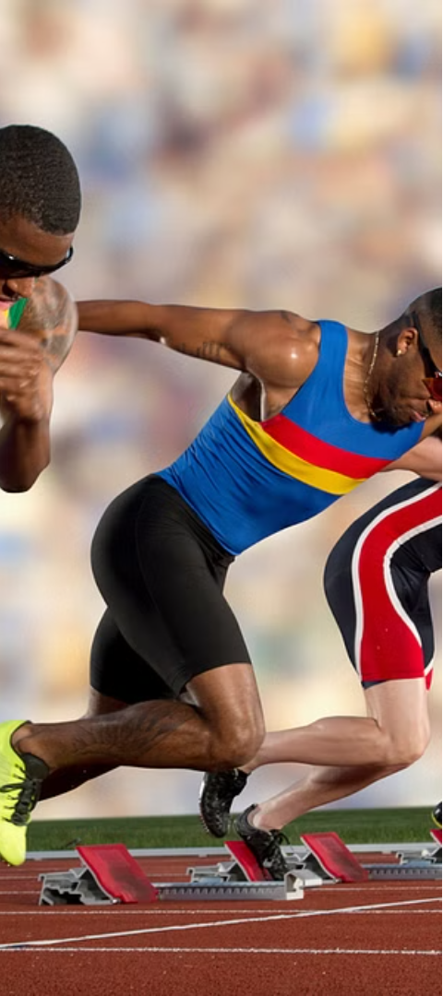



Tasks
Coach finding the ideal competition to register his athletes
Athlete finds his own statistics and those of other athletes
Athlete finds a competition that he has held for a long time.

Slide 7
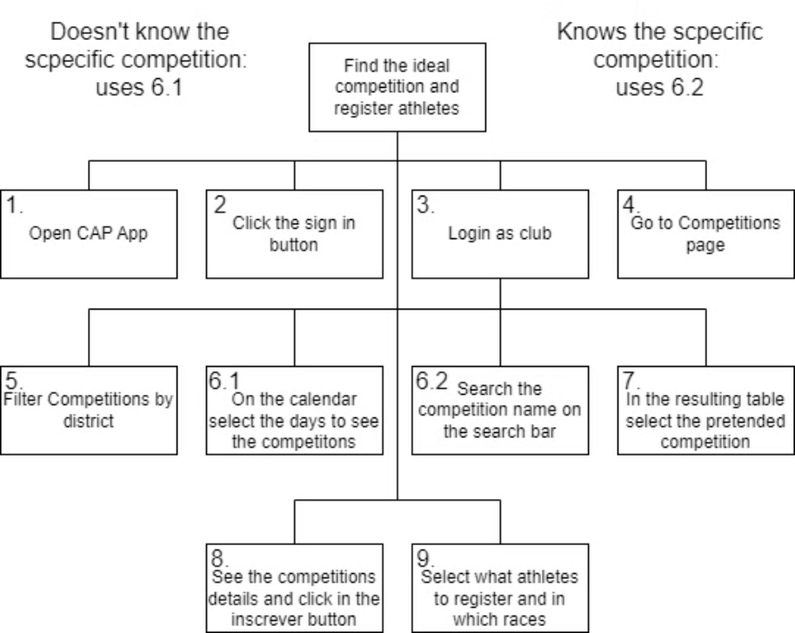
Task 1 Diagram
Coach finding the ideal competition to register his athletes

Slide 8
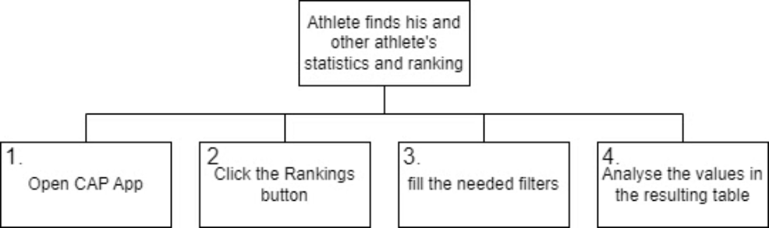
Task 2 Diagram
Athlete finds his own statistics and those of other athletes

Slide 9
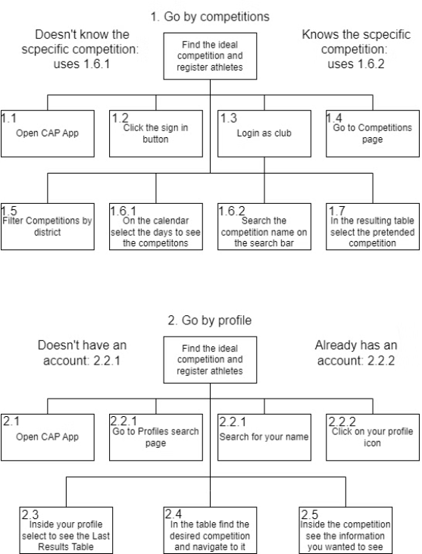
Task 3 - Diagram
Athlete finds a competition that he has held for a long time.

Slide 10
Requirements
Non Functional
Functional
•Usability
Create the Data needed for the various tables
•Easy to use
Add a carousel to main page
•Easy to learn
Add a go back to button in the top of page
•Responsive
Create the navbar with the button links to all the other pages
•Aesthetic and Minimalist Design
Add link connections in the tables for the name 'João Coelho'
Add link connections in the table for the club 'SCP'
Calendar with visual representation of competition days
Create the various tables
Add sorting options to all the columns.
Add Search bars and pagination for competitions, athlete’s, clubs and finally athlete’s rankings information
Add the default component to appear when the user search doesn't return any value
Add filters for the rankings
Add filters for competitions
Make a stylish graph to show the values of an athlete’s progression
Add a register and login option for users
The login function can be for clubs or for athletes
Add error detection for the filling of the account creation or login forms to make sure for valid inputs
Add styles and icons to the register login pages
Create a footer and add CSS to make sure it always stays at the bottom of the page even if the page is not filled with nothing else
Create a CSS style common across all pages that displays the information in a clear and well-organized manner

Slide 11




Technologies used
The low-fidelity prototype was created using Figma.
For the high-fidelity prototype construction, we used various technologies such as React, CSS, React-Bootstrap.

Slide 12
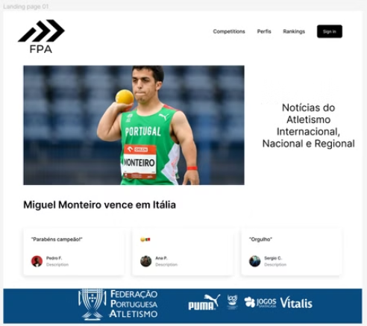
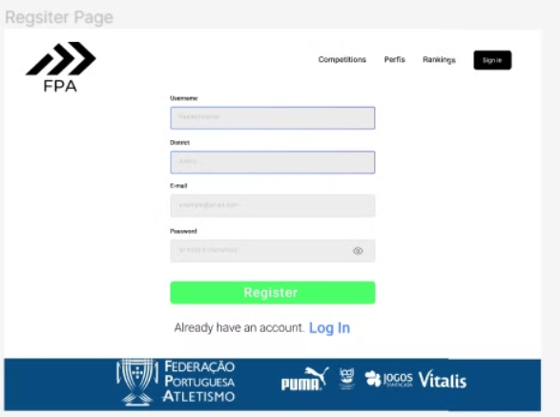
Low fidelity Prototype

Slide 13
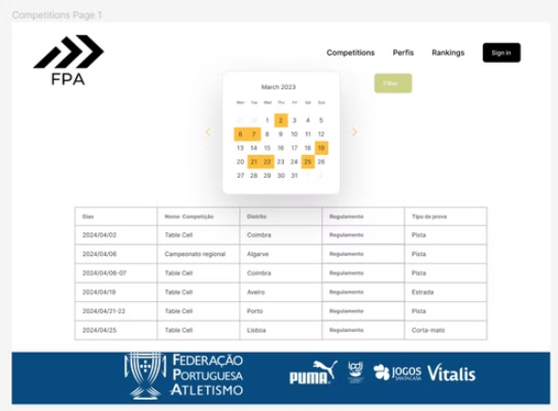
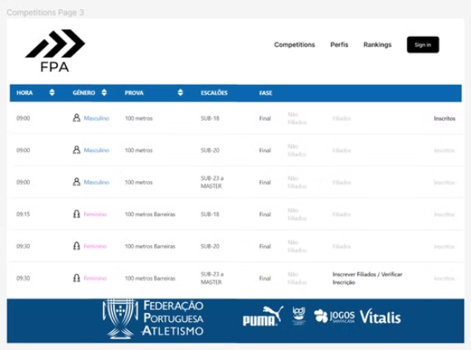
Low fidelity Prototype

Slide 14
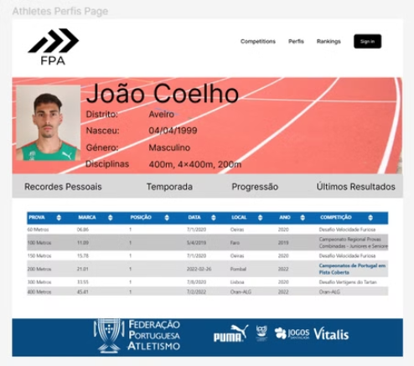
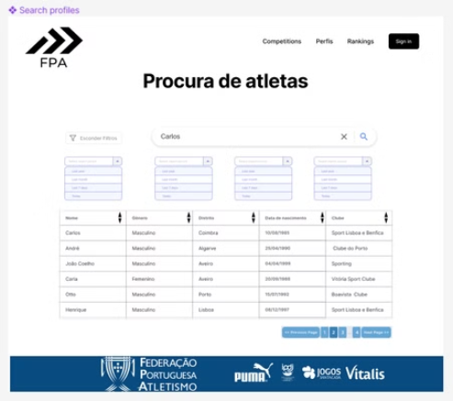
Low fidelity Prototype

Slide 15
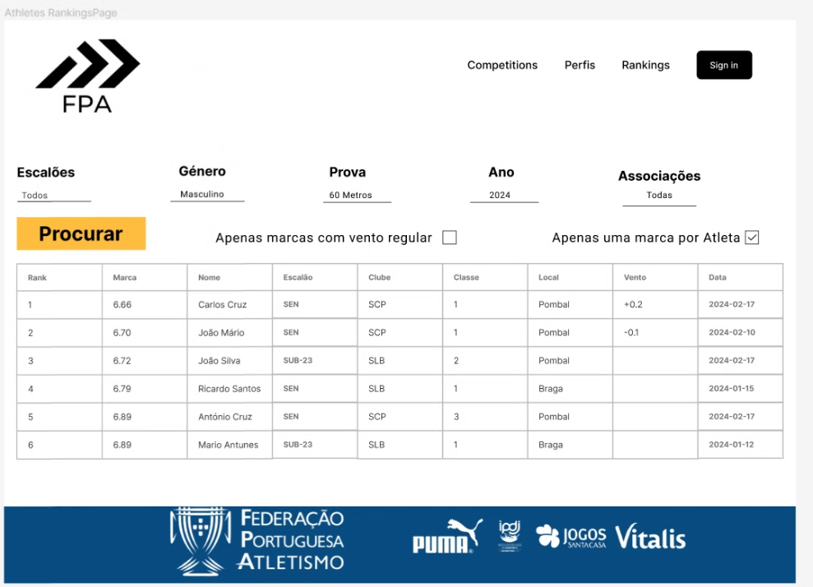
Low fidelity Prototype

Slide 16
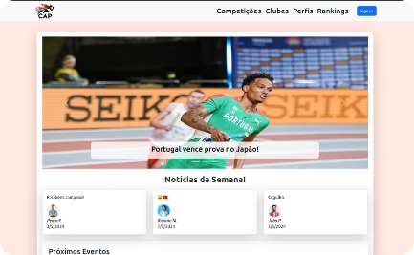
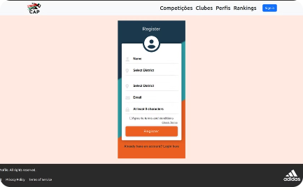
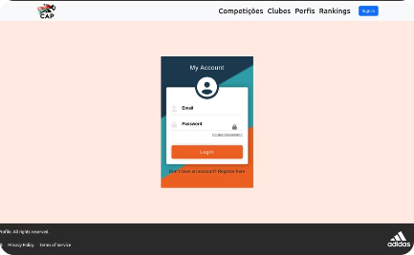
High fidelity Prototype
Main Page
Registration Page
Login Page
The main page will serve as the entry point for users, where they can access general information about the application and its main functionalities.
Users will be able to create an account on the application through this page, ensuring access to personalized functionalities..
Users will be able to log in with an account on the application through this page.

Slide 17
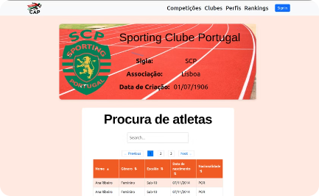
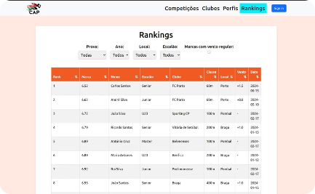
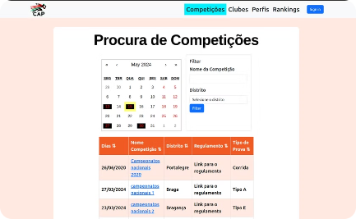
High fidelity Prototype
Club Profile Page
Athlete Ranking Page
Competition Search Page
Each athlete will have a profile page where detailed information about their performance and competition history can be viewed.
Users will be able to access athlete rankings, allowing them to track the progress and evolution of the top athletes.
On this page, users will be able to search for and find information about the different competitions organized by the CAP.

Slide 18
Methods of evaluation used
For the prototype evaluation, we employed a Heuristic Evaluation approach ourselves and beyond that, devised two usability questionnaires for 5 individuals/users to assess our prototype.
One questionnaire focused on the ease of performing tasks within the prototype, while the other, administered after completing these tasks, inquired about the overall usability of the prototype.

Slide 19
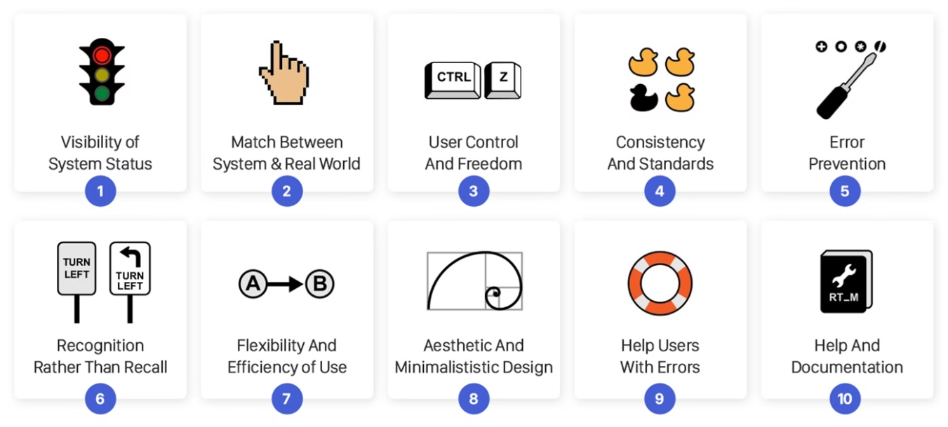
How did a Heurisitic evaluation
We conducted a Heuristic Evaluation similar to the one on the 1st Assignment website for the high-fidelity prototype, where we analyzed the prototype based on the 10 Usability Heuristics. And we build Potrotype HE - Table for more significant results.

Slide 20
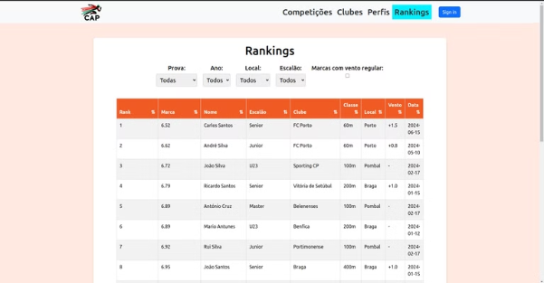
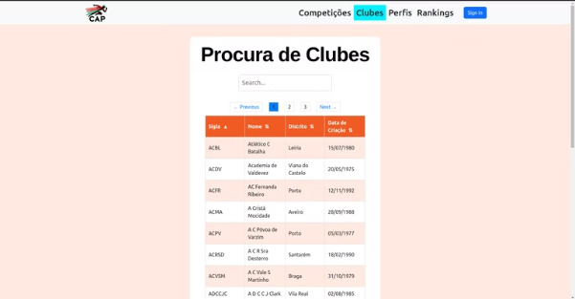
Heurisitic evaluation
Issue - Incompatibility of tables in the prototype
Heurisitc- Consistency and Standards
Severidade-2

Slide 21
Heurisitic evaluation pt. II
Issue - Lack of a "Back Button"
Heuristic - User Control and Freedom
Severity - 4

Slide 22
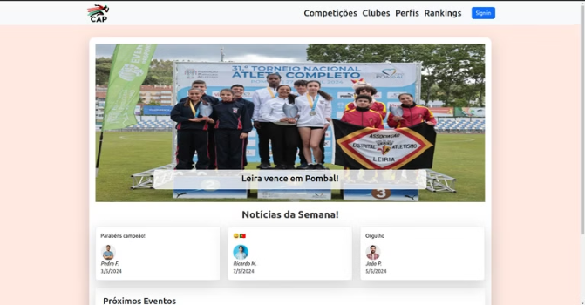
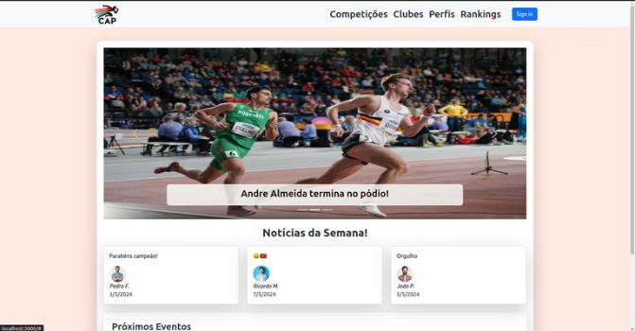
Heuristic evaluation pt. III
Issue - Comments don't change according to the news.
Heuristic - User Control and Freedom
Severity - 4

Slide 23
Potrotype HE - Table
Ricardo
Miguel
João
Média
"Back" button doesn't exist.
4
4
4
4
The calendar has errors.
3
4
4
4
Comments don't change according to the news.
3
2
3
3
Table incompatibility.
2
4
3
3
0-Not a Problem 1-Cosmetic Problem 2-Minor Usability Problem 3-Major Usability Problem 4-Usability Catastrophe

Slide 24
User Evaluation tasks
User evaluation tasks
1- View the progression of the top marks for athlete João Coelho.
2- Access the profile of SCP Club and find athlete Beatriz Santos.
3- Access the times achieved in the different heats at the 2020 national sub-18 (Junior) championships in the men's 200 meters event.
4- Log in to the site as a Club and find the upcoming competition for the national sub-18 (Junior) championships, and register my club's athletes for the 200 meters and 800 meters events.
5- Access the rankings page and view the rankings for the 100 meters event in the sub-23 (Junior) category for the year 2024 for all districts.

Slide 25
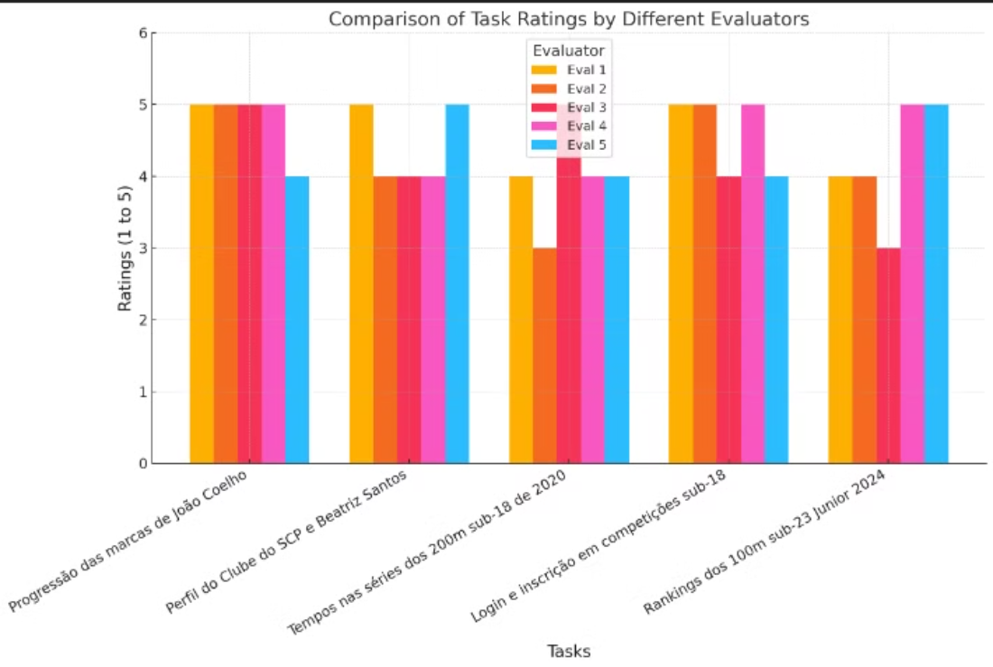
User evaluation – Graphs with the values in each

Slide 26
Pos questionere - Questions
After completing the tasks and the user evaluation, the 5 users responded to these questions:
Q1: I think that I would like to use this system frequently.
Q2: I found the system unnecessarily complex.
Q3: I thought the system was easy to use.
Q4: I think that I would need the support of a technical person to be able to use this system.
Q5: I found the various functions in this system were well integrated.
Q6: I thought there was too much inconsistency in this system.
Q7: I would imagine that most people would learn to use this system very quickly.
Q8: I found the system very cumbersome to use.
Q9: I felt very confident using the system.
Q10: I needed to learn a lot of things before I could get going with this system.

Slide 27
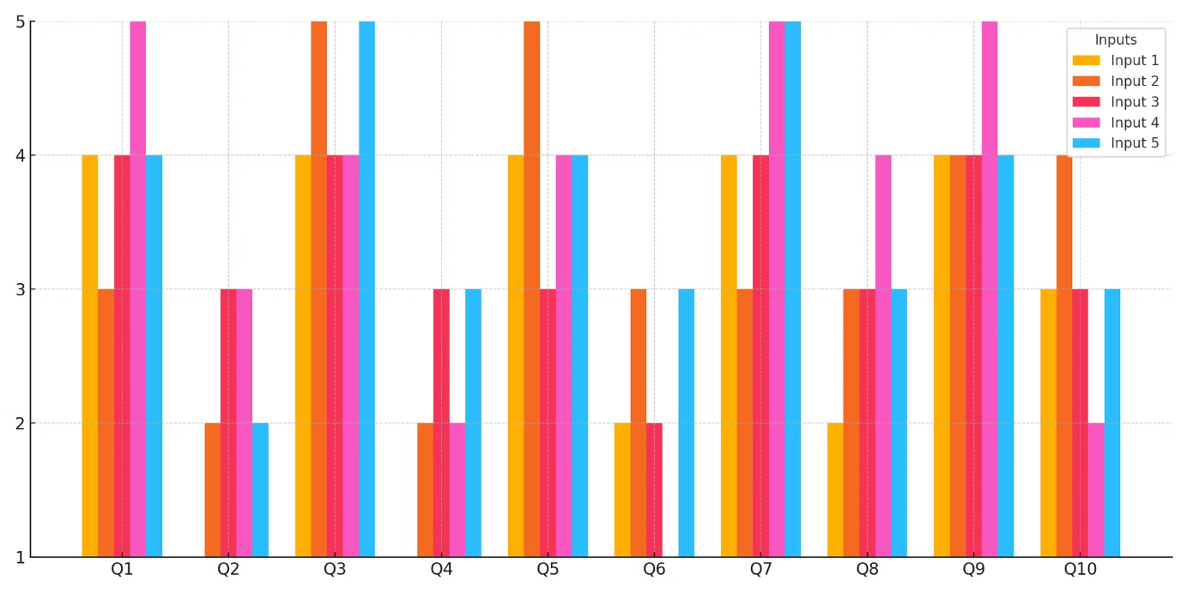
Pos questionere
Scale: 5 - Totally agree to 1 - Totally disagree

Slide 28

DEMO

Slide 29
Next Steps – Things we might still add until delivery day
Add a feature that allows users to compare their marks to peers or other athletes
Implement a notification system that sends alerts to clubs when registration for upcoming competitions opens.
Improve table responsiveness for smaller screens
Team Effort:
Miguel-2/7 João-2/7 Ricardo-3/7

Slide 30
Results/Conclusion
Project's best Features:
Enhanced navigation with a dynamic navbar.
Clearer information presentation with improved tables.
User-friendly features like search bars, sorting options, and pagination.
Visually appealing design and consistent user interaction across all pages.
Features Still to Upgrade:
Create compatible and attractive styles for all pages to improve responsiveness and flexibility for different screen sizes.
Develop a calendar to visually display competition days and integrate with other functionalities and page styles.
Final Conclusion: We have successfully created a more user-friendly website that makes it easier to find information about Portuguese athletics. This enhancement benefits athletes, coaches, and users by providing a more intuitive and enjoyable browsing experience.

